Slide 1

Design of a hardware Root-of-Trust
on embedded systems
Eros Camacho-Ruiz
Supervisors:
Dr. Piedad Brox Jiménez
Prof. Francisco Vidal Fernández Fernández
Sevilla, March 13th 2024

Slide 2

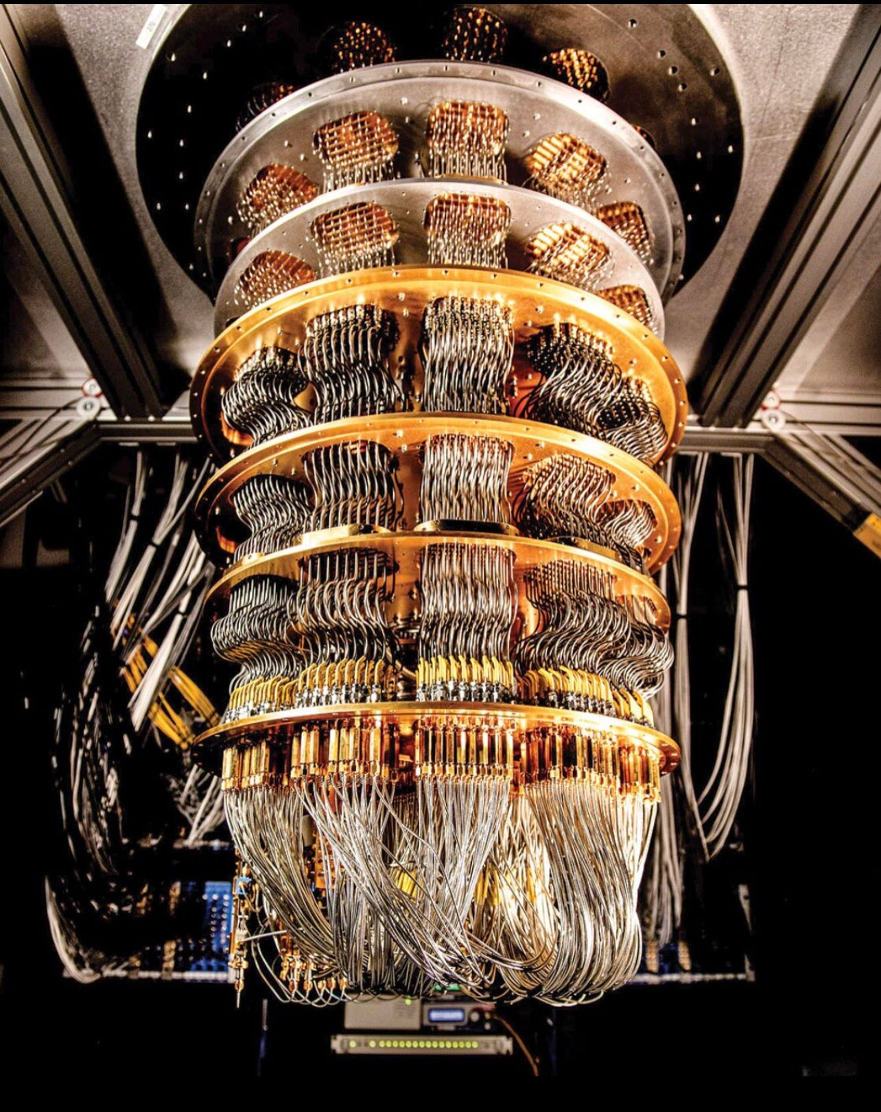




Introduction
Critical Infraestructure
Data privacy preserving
Economic and National Security Implications
Global Communications
Cybersecurity
Information security
2

Slide 3
Introduction
Hypothesis
Contributing to improve the security of information using hardware solutions in IoT environments where restrictions are usually stronger.
How ?
Proposing a Root-of-Trust composed of different modules that have been designed separately.
Use Cases to demonstrate the feasibility of the dissertation
3

Slide 4
Overview
Dissertation
Structure
RTN-based PUF
Hash Functions
Evaluation
Analog low-level design
SHA-2
RTL design
Digital low-level design
SHA-3
RTL design
PQC
NTRU
PoC
HMAC
NTRU
4

Slide 5


What is a PUF ?
Physical Unclonable Function (PUF)
INPUT
Challenge
PUF
OUTPUT
Response
Key Obfuscation
Device identification
5

Slide 6
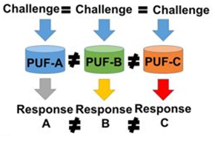
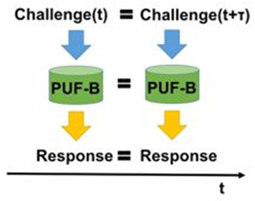
What is a PUF ?
Response Characteristics
Unique
Unpredictable
Reliable
6

Slide 7
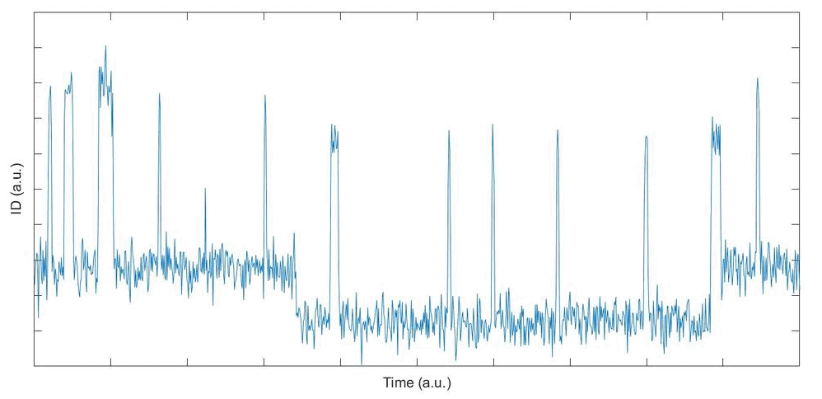
A novel RTN-based PUF
Patent: WO/2023/202843
MÉTODO Y DISPOSITIVO PARA FUNCIÓN FÍSICA NO CLONABLE (PUF) BASADA EN RUIDO TELEGRÁFICO ALEATORIO (RTN)
Random Telegraph Noise (RTN)
Low biasing voltages → Prevent aging
Handle the RTN
Cumulative difference between the maximum and the minimum in a time interval of a drain
CURRENT / VOLTAGE trace
Maximum Parameter Fluctuation
(MPF)
7

Slide 8
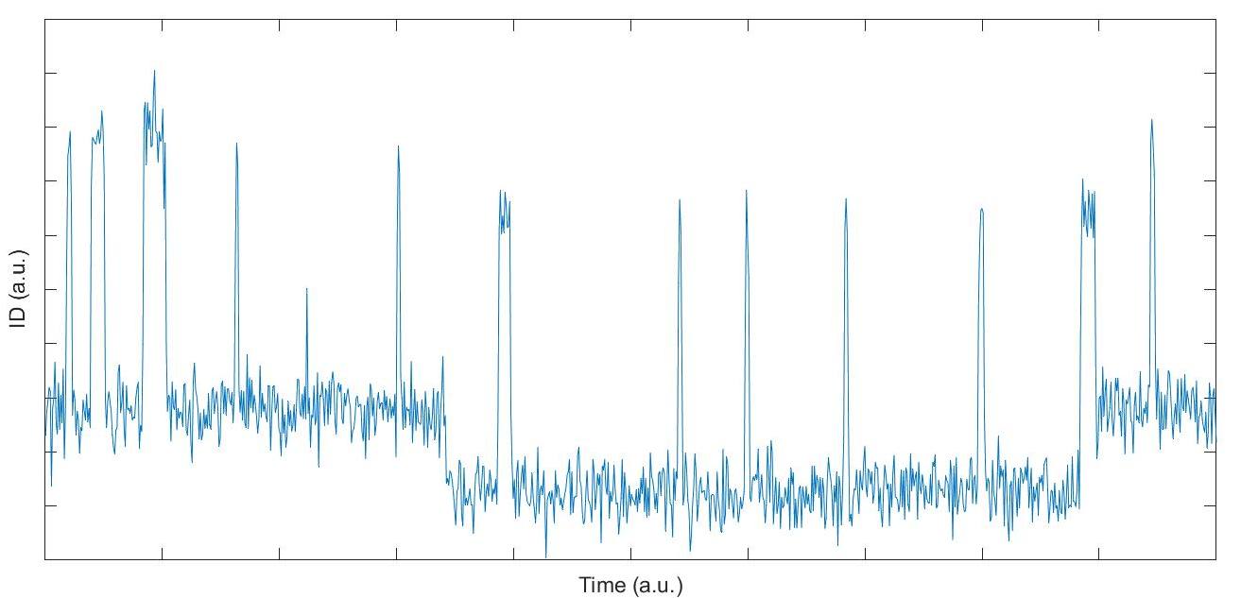
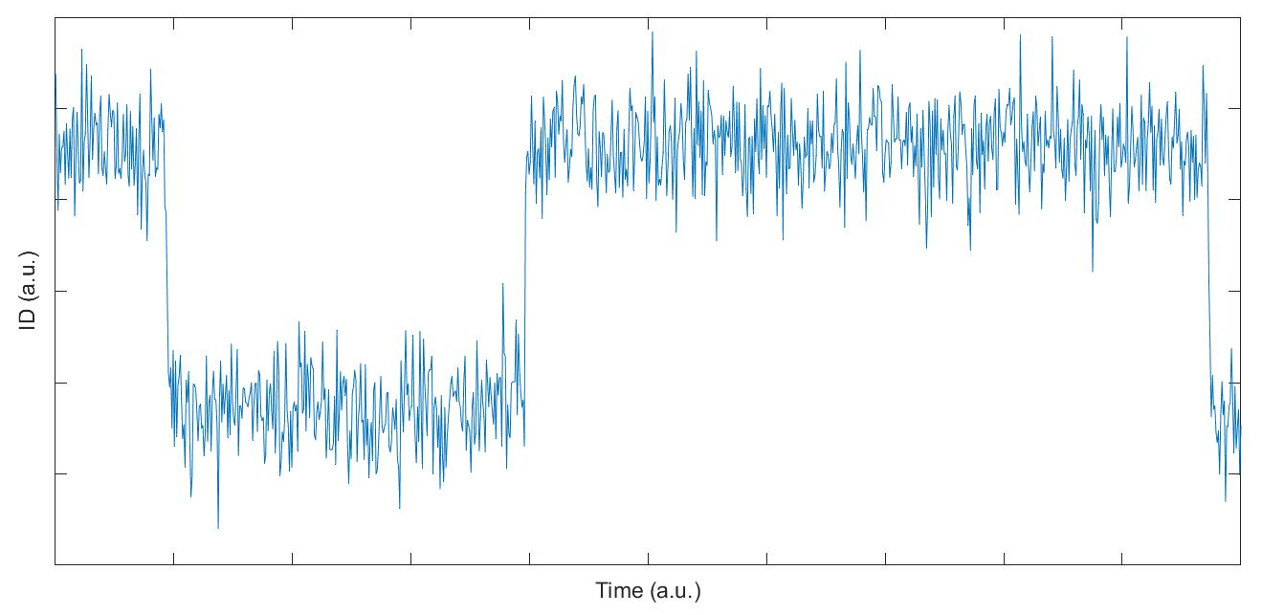
A novel RTN-based PUF: Schematic
Pair of transistors
Current/Voltage trace with RTN
Current/Voltage trace with RTN
MPF
Comparison
MPF
1-bit Response = {0,1}
8

Slide 9
A novel RTN-based PUF: Architecture
Architecture
Single
VOLTAGE
CURRENT
Differential
VOLTAGE
CURRENT
9

Slide 10
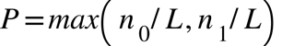

A novel RTN-based PUF: Metrics
Probability
Metrics
Probability (P)
Reliability (1-HDIntra)
Number of zeros/ones → $n_{0}$ / $n_{1}$
Number of measurements → $L$
Uniqueness (HDInter)
Unpredictability (HW)
Bit Selection Method
10

Slide 11
A novel RTN-based PUF: Evaluation
Is it feasible to build a PUF based on RTN?
How sizes and biasing conditions can alter the PUF performance?
Evaluation
How non-idealities of the circuitry needed to get the response can affect the PUF performance?
Differential Current mode
Low-level design
11

Slide 12
A novel RTN-based PUF: Evaluation #1
Is it possible to obtain a reliable response from this PUF?
Comparing with similar area PUFs
32-bit response
 | [7] Mispan, IEEE Prime 2015 | [8] Mispan, IOLTS 2016 | [9] Zhuang, IEEE TCAS I, 2020 | This diss.
Reliability (%) | 91.58 | - | 94.2 | 99.8
HD_{inter} (%) | 50.23 | 49.9 | 49.9 | 49.99
HW (%) | - | 53.94 | 53.94 | 50.09
Comparing with similar quality metrics PUFs
128-bit response
 | [14] Yoshinaga ISCAS 2016 | [12] Santana-Andreo, Integration, 2022 | This diss.
Reliability (%) | 99.99 | 99.99 | 99.99
HD_{inter} (%) | 48.0 | - | 49.97
HW (%) | - | 50 | 49.96
Technology | 65-nm | 65-nm | 65-nm
Number of transistors | 34,816 (2,048 17T-ROs) | 4,992 (832 6T-SRAM cells) | 2,286
12

Slide 13
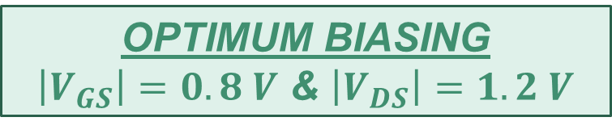
A novel RTN-based PUF: Evaluation #2
How sizes and biasing conditions can alter the PUF performance?
Larger Transistors
Stable Pairs
↓ Smaller Transistors
↓ Area Cost per Bit
OPTIMUM BIASING
$\left|V_{GS}\right|=0.8 V$ & $\left|V_{DS}\right|=1.2 V$
OPTIMUM SIZE
80x60 nm²
13

Slide 14
A novel RTN-based PUF: Evaluation #3
How non-idealities of the circuitry needed to get the response can affect the PUF performance?
Non-idealities of the circuitry can affect the performance of the PUF
MCF Extractor and Comparator must be carefully designed
The on-resistance and off-resistance of the transistor selector can affect the performance
14

Slide 15
Low-level design of the RTN-based PUF
Evaluation
Low-level design
Analog design flow
Differential Voltage mode
Avoiding potential issues in current sensing
Examination of different ICC in CC method can improve the PUF quality.
In case aging impacts the PUF, adjusting voltage levels is a simple task.
15

Slide 16
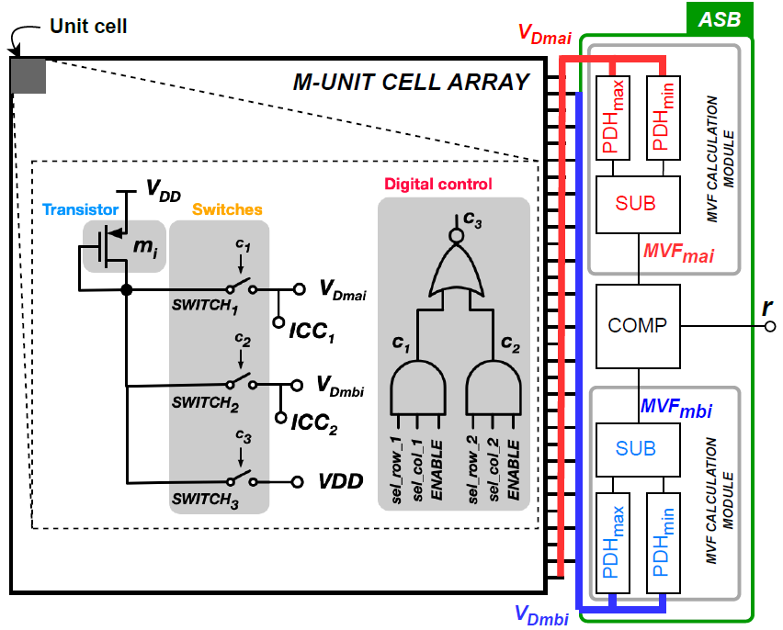
Low-level design: floorplan
16

Slide 17
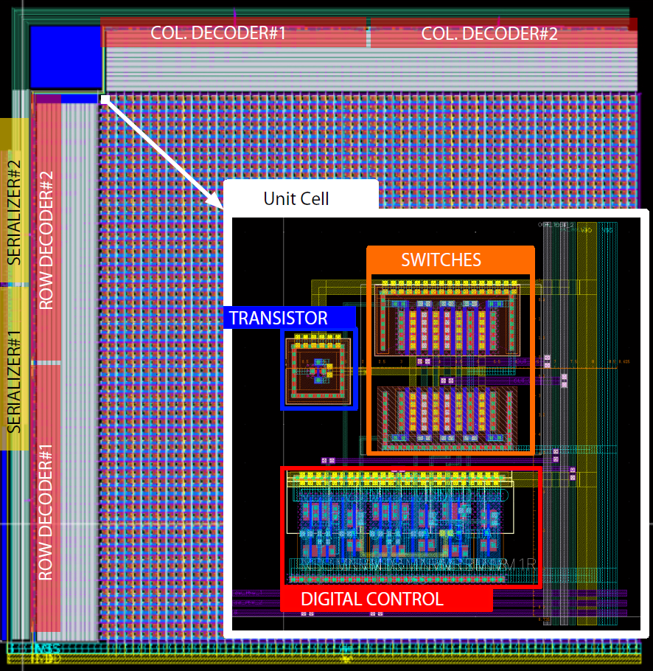
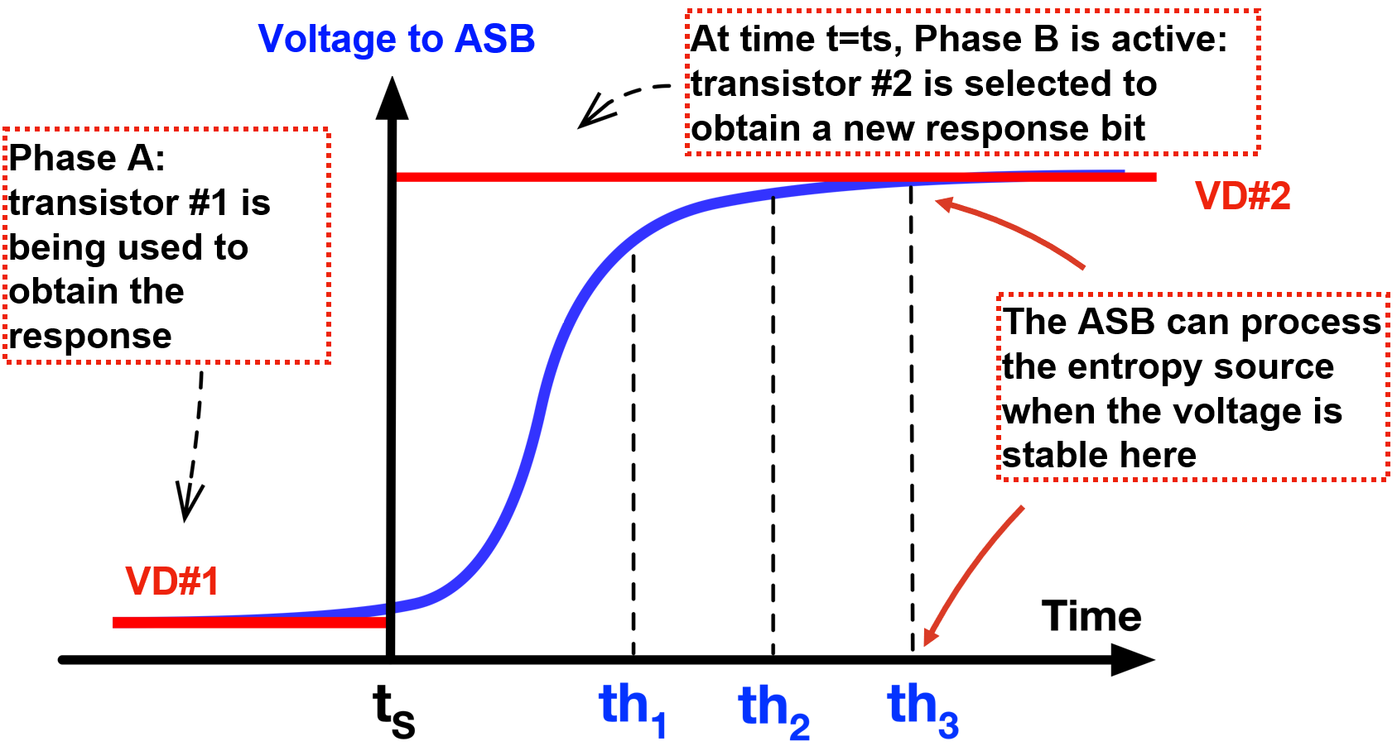
Low-level design: array design
OPTIMUM SIZE
L = 100nm
W = 2um
4,096 transistors
tmin = 10us
17

Slide 18
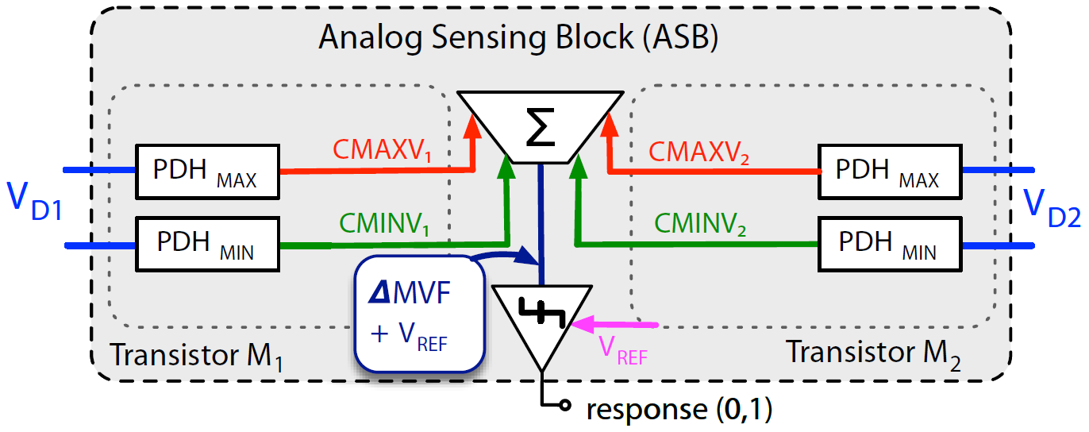
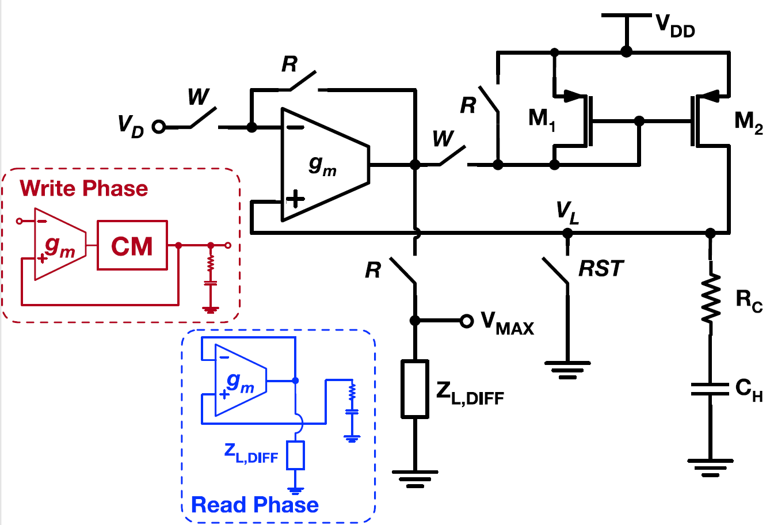
Low-level design: ASB design
PDH design
Circuit | Static Error (mV)
 | µ | σ
PDH_{MAX} | 0.5319 | 0.141
PDH_{MIN} | 0.8405 | 0.250
18

Slide 19
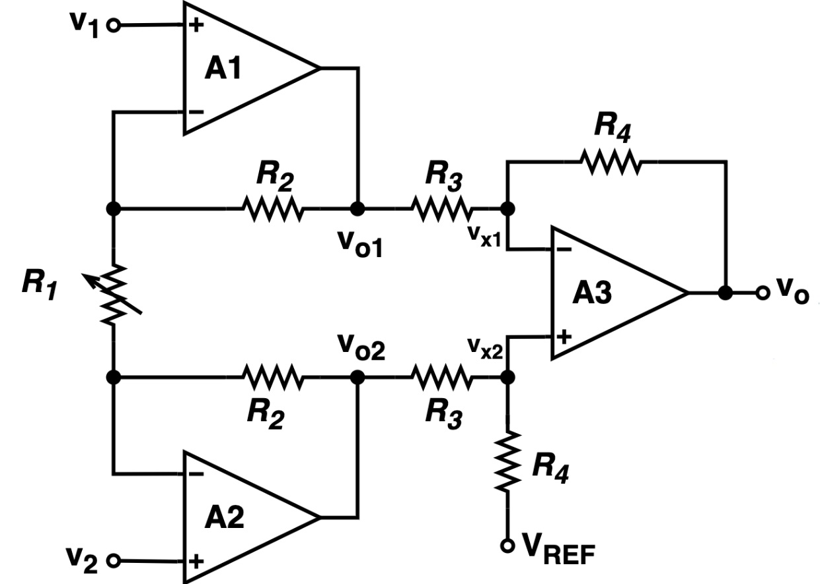
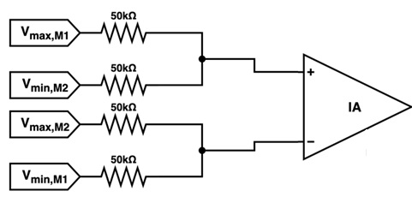
Low-level design: ASB design
Substractor design
19

Slide 20
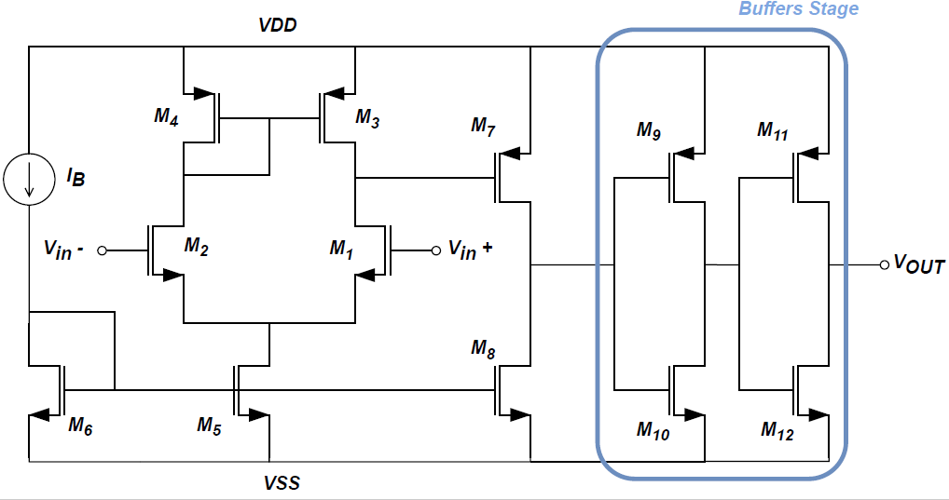
Low-level design: ASB design
Comparator design
20

Slide 21
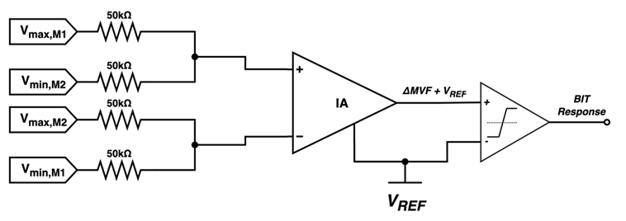
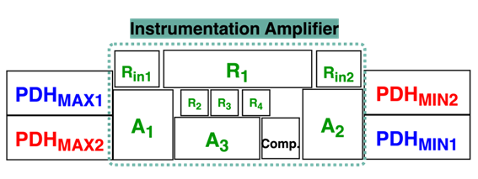
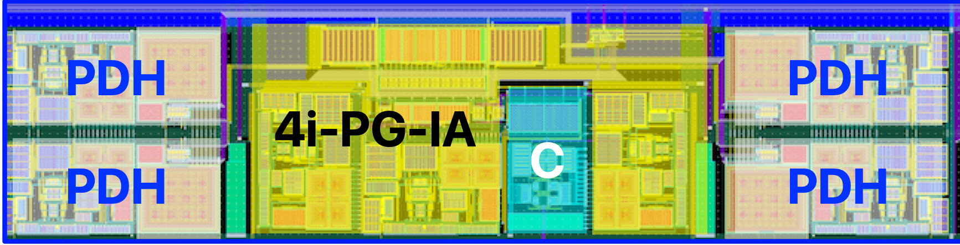
Low-level design: ASB design
21

Slide 22
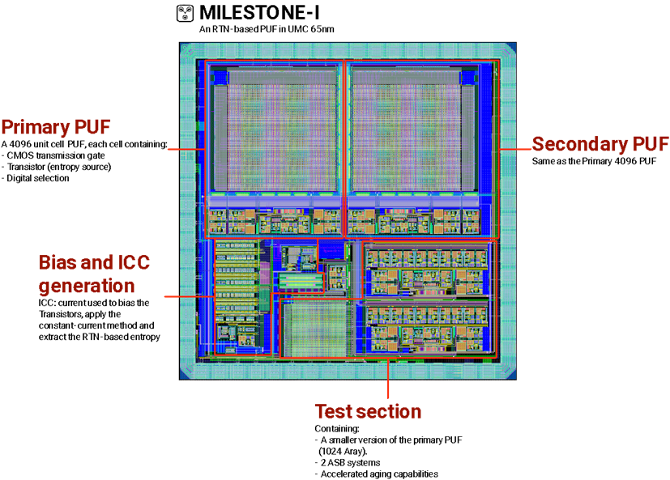
Low-level design: Milestone - I
22

Slide 23
Hash Functions
Hash Functions
Verification of message integrity
Signature generation and verification
Password hashing
Key derivation
Collision Resistance
Preimage resistance
Second Preimage resistance
NIST
SHA-2
SHA-3
23

Slide 24
Hash Functions
Competitive trade-off between time and area
Comparison with the SATO
Desing of a highly configurable IP: AXI4-Lite
ASIC implementation of the SHA-256
Drivers to use the IP module
24

Slide 25
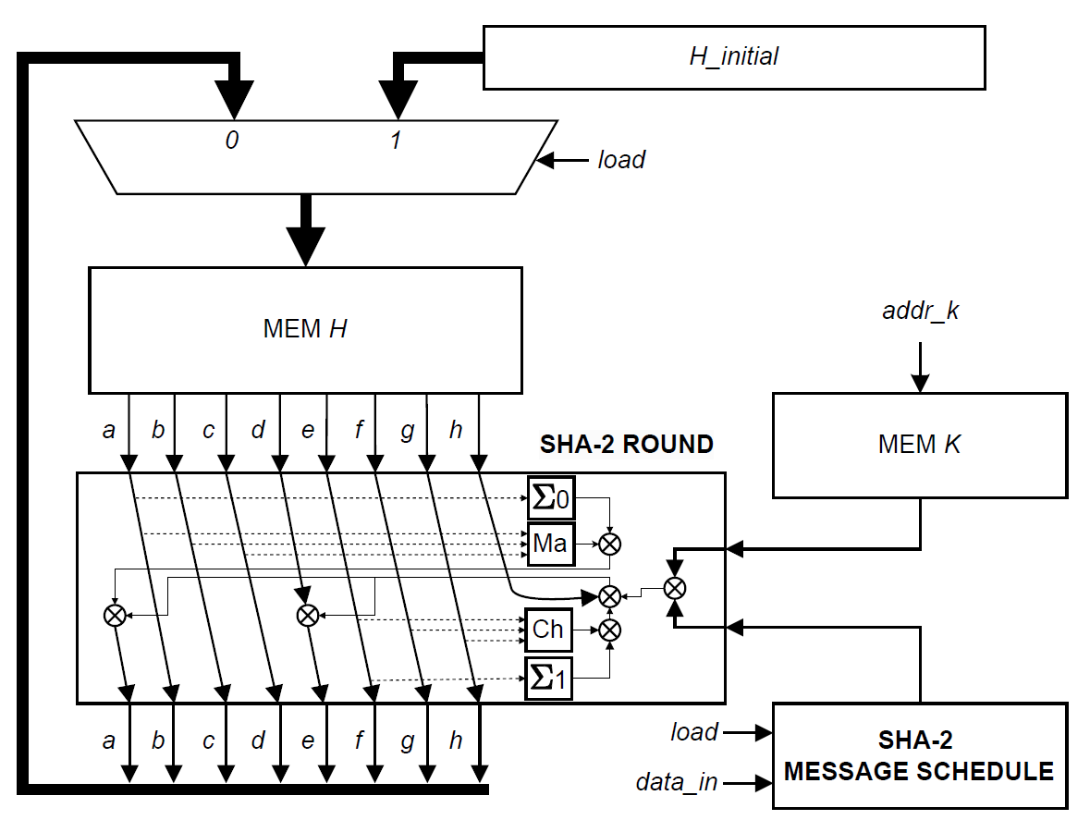
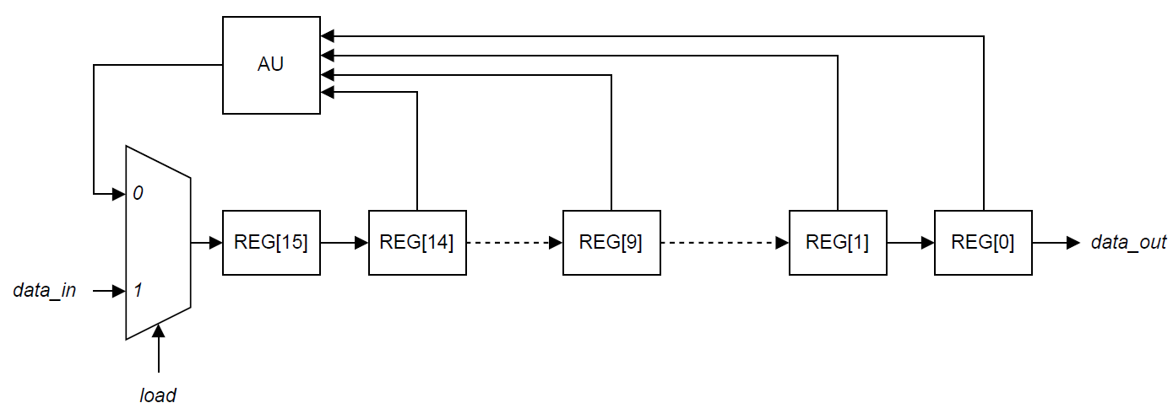
SHA-2
SHA-2 Core
Message Schedule
25

Slide 26
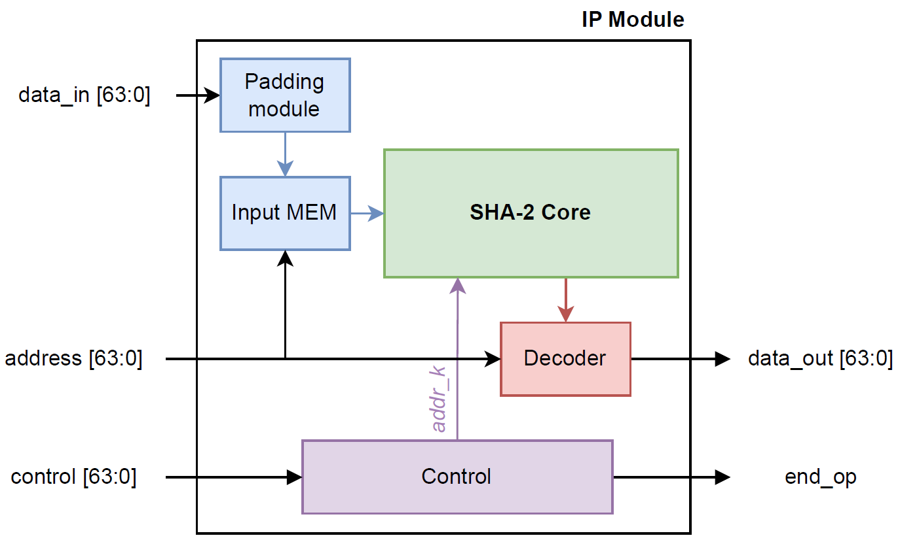
SHA-2
SHA-2 IP
26

Slide 27
SHA-2
Ref | Platform | SHA-2 ver. | Area | Frequency | Throughput | Efficiency
 |  |  | (Slices) | (MHz) | (Gbps) | (Mbps/Slice)
[89] | Virtex | SHA-256 | 755 | 174.00 | 1.370 | 1.830
[90] | Virtex | SHA-256 | 6136 | 35.10 | 2.077 | 0.338
[91] | Virtex-5 | SHA-256 | 387 | 202.54 | 1.580 | 4.190
[92] | Virtex-4 | SHA-256 | 610 | 170.75 | 1.345 | 2.200
[93] | Virtex-5 | SHA-256 | 1895 | 411.30 | 3.290 | 1.740
This diss. | Virtex-7 | SHA-256 | 282 | 191.13 | 1.630 | 5.784
[89] | Virtex | SHA-512 | 1667 | 141.00 | 1.780 | 1.010
[91] | Virtex-5 | SHA-512 | 874 | 176.06 | 2.200 | 2.580
[94] | Virtex-5 | SHA-512 | 1080 | 129.00 | 0.826 | 0.765
This diss. | Virtex-7 | SHA-512 | 576 | 173.52 | 2.221 | 3.856
27

Slide 28
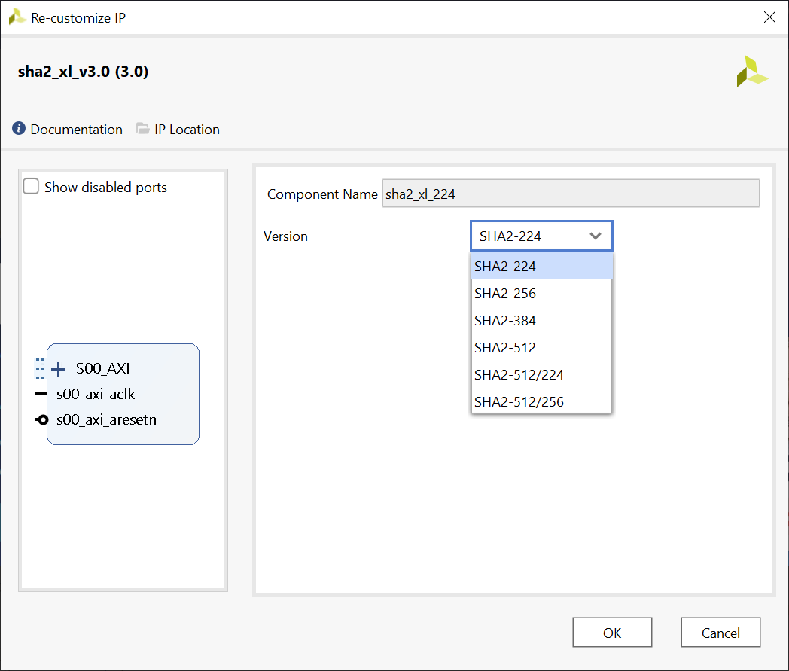
SHA-2
SHA-2 IP Interface
SHA-2 | Message Length | Throughput
Instance | < Block Size | > Block Size
SHA-224 | x0.68 | x0.87
SHA-256 | x0.67 | x0.87
SHA-384 | x1.54 | x2.35
SHA-512 | x1.44 | x2.32
SHA-512/224 | x1.64 | x2.35
SHA-512/256 | x1.64 | x2.37
28

Slide 29
SHA-256 low-level design
RTL design
Low-level design
Digital design flow
SHA-256
Modifications
Inferring registers and memory cells instead of BRAMs.
Adding an interface
29

Slide 30
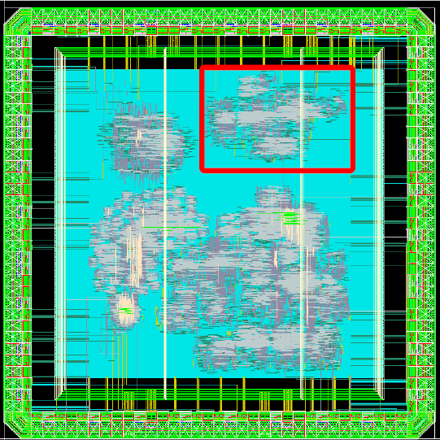
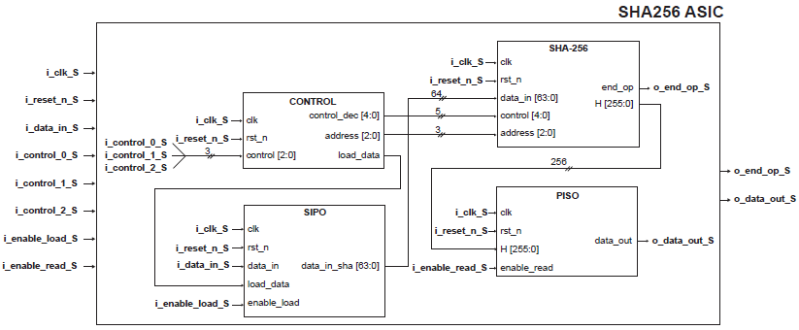
SHA-256 low-level design
Occupation
Layout
Low-level schematic
Module | Cell Count (GE) | Cell Area(µm²) | Net Area(µm²) | Total Area(µm²)
SIPO | 261 | 1317.240 | 742.423 | 2059.663
PISO | 516 | 2507.400 | 1479.523 | 3986.923
Control | 52 | 181.440 | 2594.252 | 2775.692
SHA-256 (Core) | 19350 | 118787.400 | 70292.775 | 189080.175
Total | 20179 | 122793.480 | 75108.973 | 197902.453
30

Slide 31
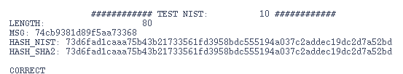
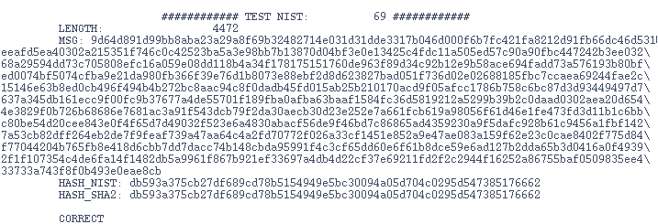
SHA-256 low-level design tests
NIST Test Vector
31

Slide 32
SHA-3
NIST
SHA-2
SHA-3
SHA-3 family has relatively fewer implementation costs and is much faster
SHA-3 family is noted as PQC primitive
SHA-3 is based in the Keccak algorithm
32

Slide 33
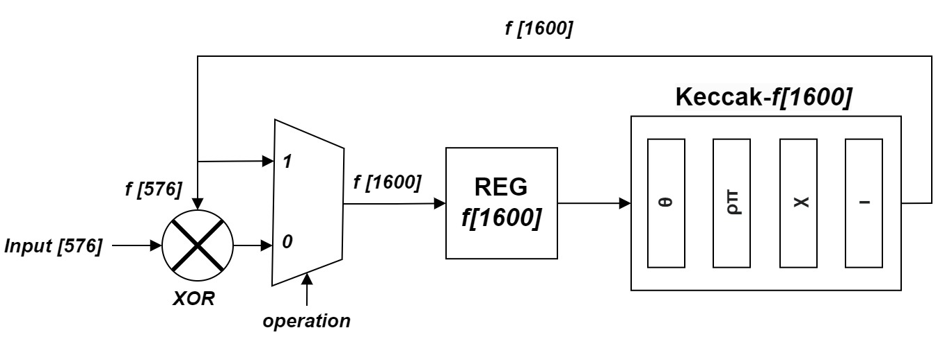
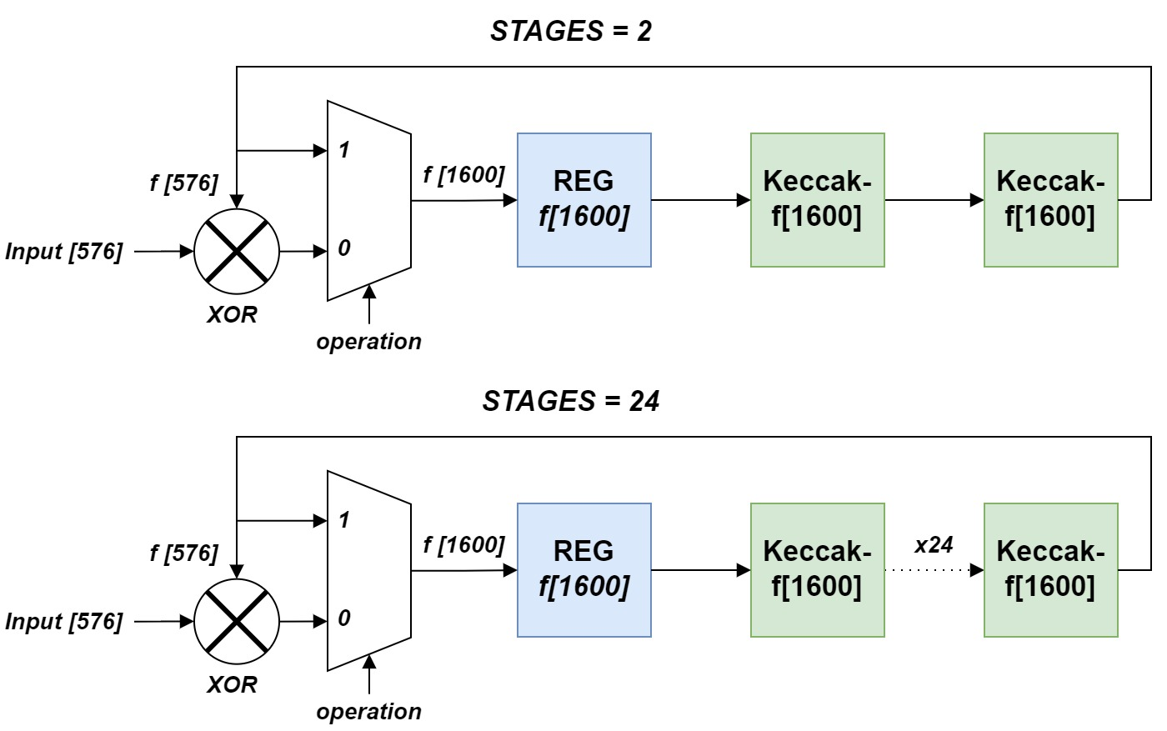
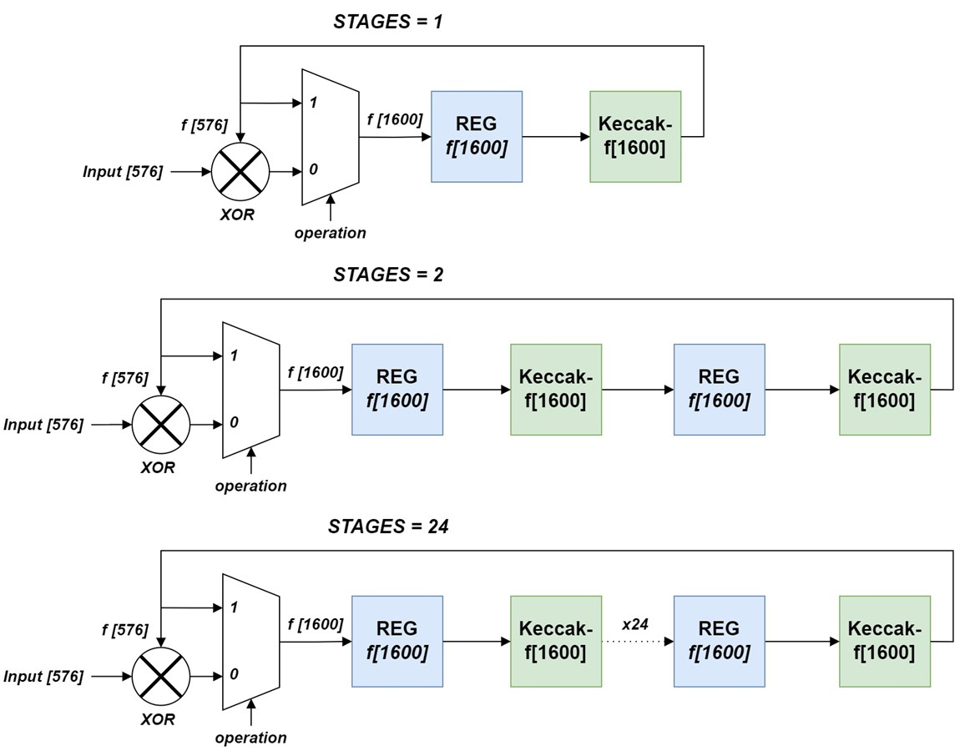
SHA-3
Basic version
Opt. #1
Opt. #2
33

Slide 34
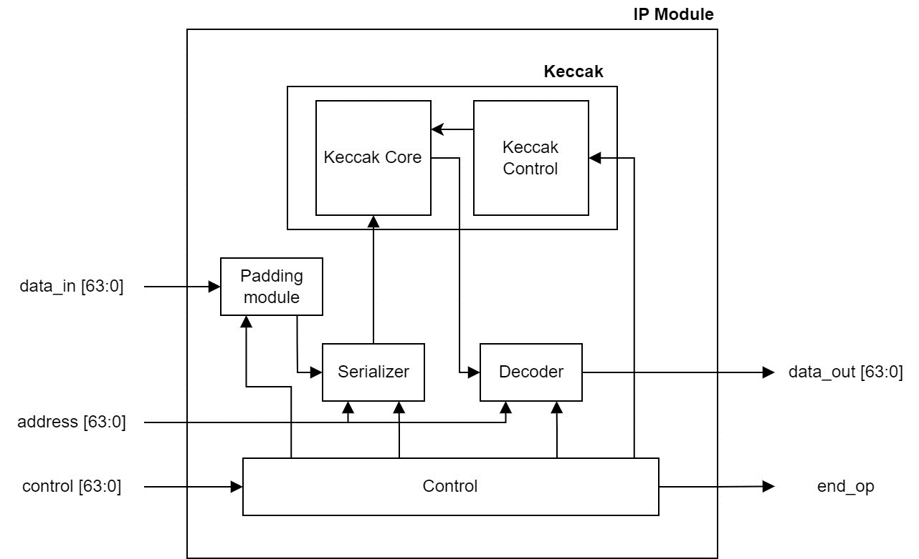
SHA-3
SHA-3 IP
34

Slide 35
SHA-3
Ref | Platform | SHA-3 ver. | Area | Throughput | Efficiency
 |  |  | (Slices) | (Gbps) | (Mbps/Slice)
[88] | Virtex-6 | SHA3-512 | 1406 | 16.51 | 11.47
[107] | Virtex-6 | SHA3-512 | 2296 | 18.78 | 8.17
[110] | Virtex-5 | SHA3-512 | 1163 | 7.80 | 6.06
This diss. | Virtex-7 | SHA3-512 | 1456 | 17.97 | 12.34
[109] | Virtex-7 | SHA3-256 | 1618 | 20.08 | 12.90
[108] | Virtex-7 | SHA3-256 | 1418 | 14.30 | 11.97
This diss. | Virtex-7 | SHA3-256 | 1566 | 29.25 | 18.68
[111] | Zynq-7000 | SHA3-224 | 1424 | 12.8 | 8.98
This diss. | Zynq-7000 | SHA3-224 | 1577 | 30.00 | 19.02
35

Slide 36
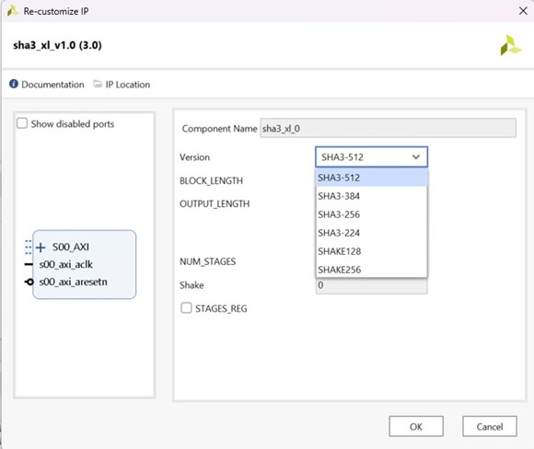
SHA-3
SHA-3 IP Interface
SHA-3 | Message Length | Throughput
Instance | < Block Size | > Block Size
SHA3-224 | x6.23 | x10.89
SHA3-256 | x6.41 | x11.71
SHA3-384 | x6.77 | x14.54
SHA3-512 | x7.33 | x19.93
SHAKE128 | x2.80 | x8.18
SHAKE256 | x3.07 | x9.64
36

Slide 37
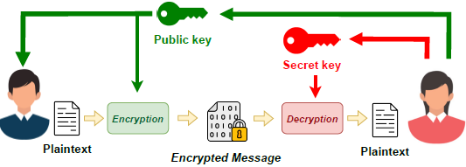

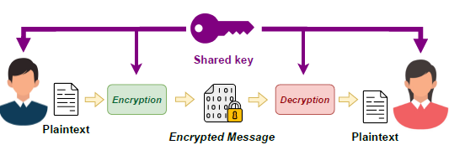
Post-Quantum Cryptography
Quantum Computers
Public key Scheme
Shor Alg.
Secret key Scheme
Grove Alg.
37

Slide 38


Post-Quantum Cryptography
Shor Alg.
Post-Quantum Cryptography
Grove Alg.
Third Round
(2020)
Selected Algorithms
(2022)
First Draft
(2023)
NTRU
Implementing the polynomial multiplier in HW
38

Slide 39
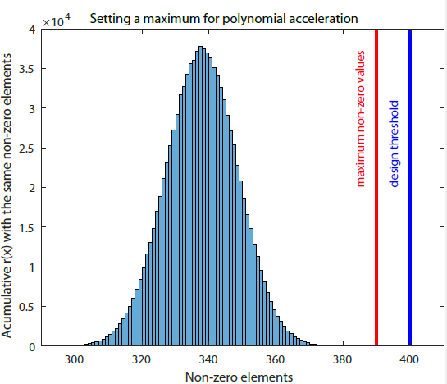
PQC: NTRU
Accelerating N cycles when a 0 is found in the blind polynomial
NTRU (IEEE 1363.1)
Can we use this strategy with NTRU Round-3 ?
The number of non-zeros of the blind polynomial is not constant
Disclosing information that has to be hided through timing attacks
NTRU (Round-3)
New Strategy
Confident Limit
39

Slide 40
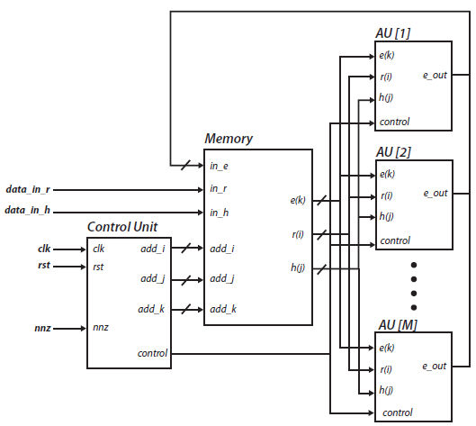
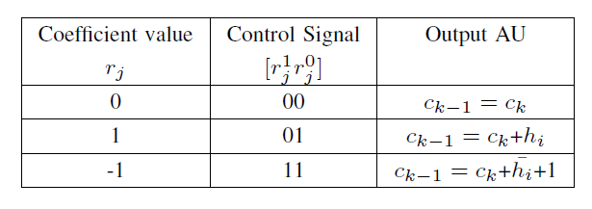
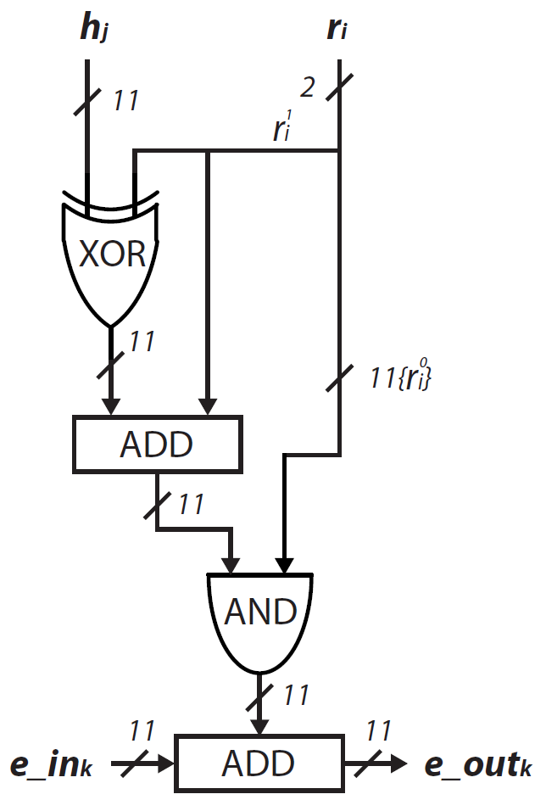

PQC: NTRU
$$e\left(x\right)=\left(h\left(x\right)×r\left(x\right)+m\left(x\right)\right) mod q$$
Parallelization
strategy
40

Slide 41
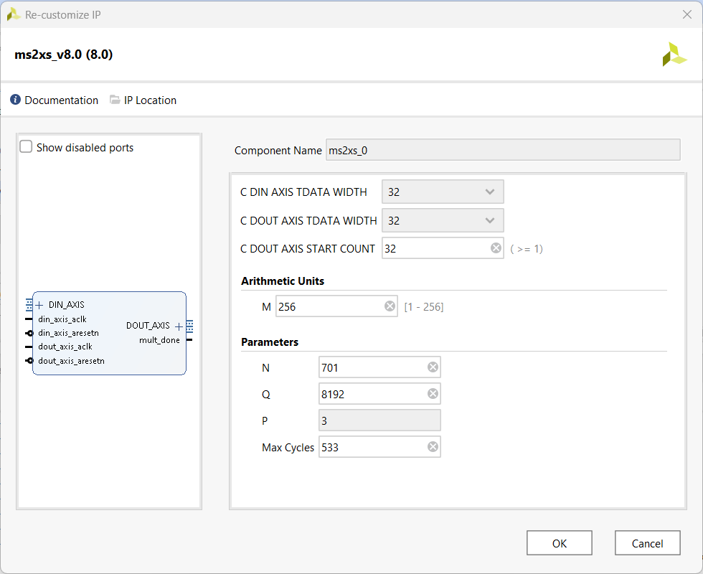
PQC: NTRU
N max_{coef} | Max. Eff. | M | LUTs | FFs | BRAM | Acc. (x)
 | LUT | 4 | 285 | 119 | 4.5 | 20.67
400 | FF | 7 | 437 | 124 | 7.5 | 30.28
509 | BRAM | 8 | 584 | 205 | 4.5 | 32.81
 | LUT | 6 | 348 | 105 | 6.5 | 23.40
509 | FF | 7 | 399 | 106 | 7.5 | 26.00
 | BRAM | 8 | 556 | 187 | 4.5 | 28.35
 | LUT | 8 | 476 | 128 | 8.5 | 37.46
516 | FF | 10 | 582 | 133 | 10.5 | 43.08
677 | BRAM | 11 | 801 | 251 | 6.0 | 45.49
 | LUT | 8 | 451 | 108 | 8.5 | 31.23
677 | FF | 10 | 558 | 113 | 10.5 | 36.40
 | BRAM | 11 | 773 | 231 | 6.0 | 38.64
 | LUT | 8 | 510 | 129 | 8.5 | 40.06
625 | FF | 12 | 713 | 133 | 12.5 | 51.89
821 | BRAM | 13 | 981 | 287 | 7.0 | 54.25
 | LUT | 8 | 481 | 109 | 8.5 | 32.94
821 | FF | 12 | 679 | 113 | 12.5 | 43.74
 | BRAM | 13 | 929 | 267 | 7.0 | 45.99
 | LUT | 6 | 433 | 130 | 6.5 | 32.26
533 | FF | 10 | 634 | 133 | 10.5 | 43.54
701 | BRAM | 11 | 881 | 273 | 6.0 | 46.32
 | LUT | 6 | 403 | 110 | 6.5 | 25.52
701 | FF | 10 | 605 | 113 | 10.5 | 36.62
 | BRAM | 11 | 854 | 253 | 6.0 | 39.18
IP Interface
41

Slide 42
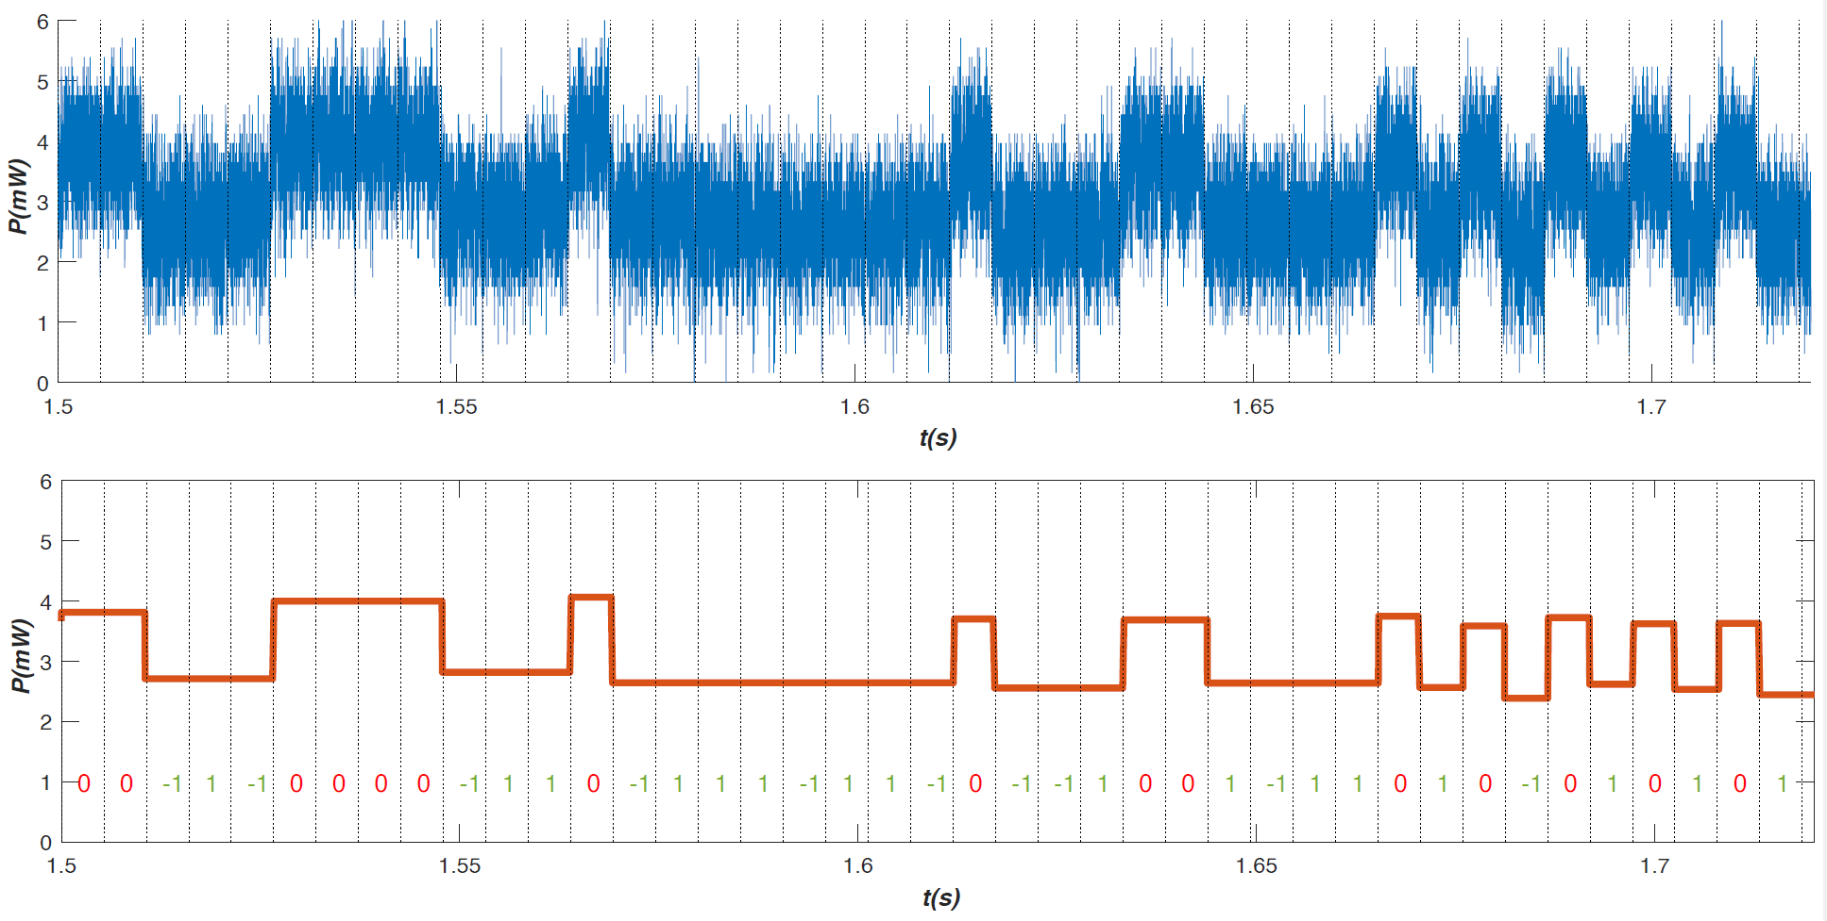
PQC: NTRU SCA
Can that lead somehow to a leak of information ?
Single Power Analysis (SPA)
There is leakage of information
Applying countermeasures …
42

Slide 43
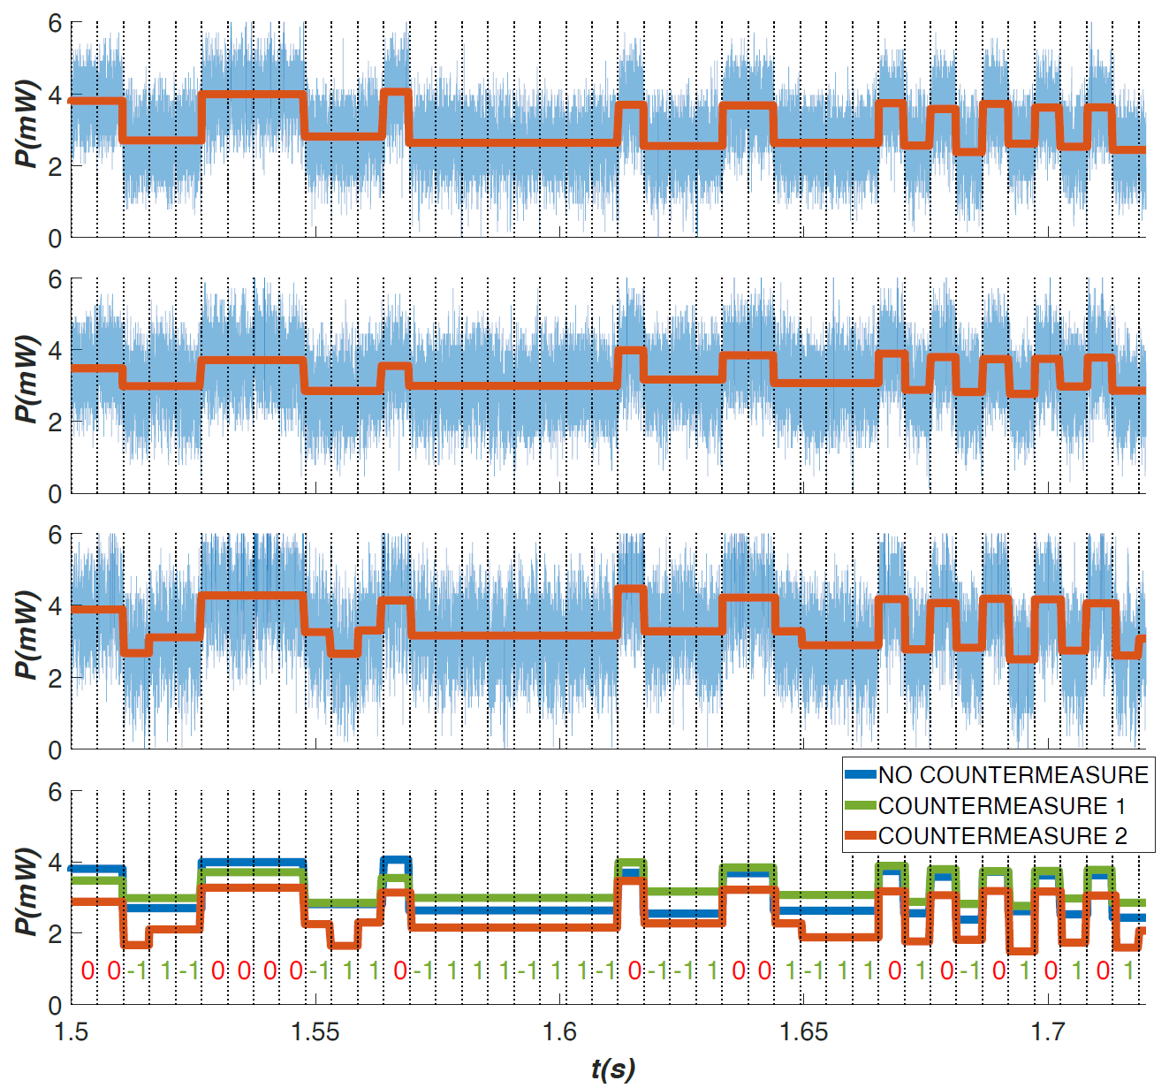
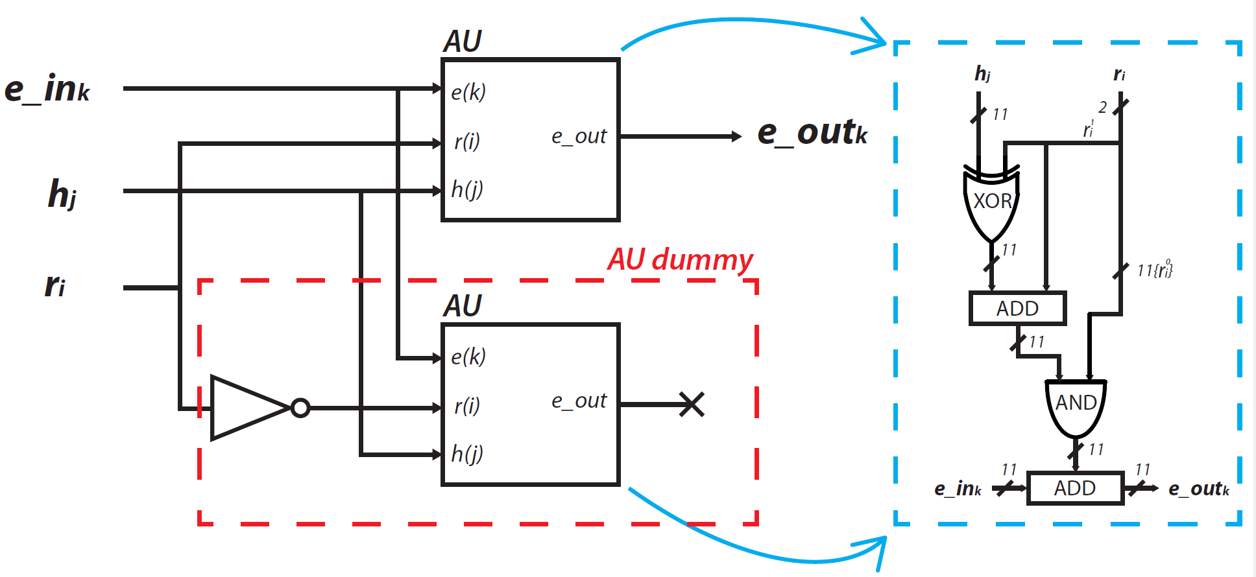
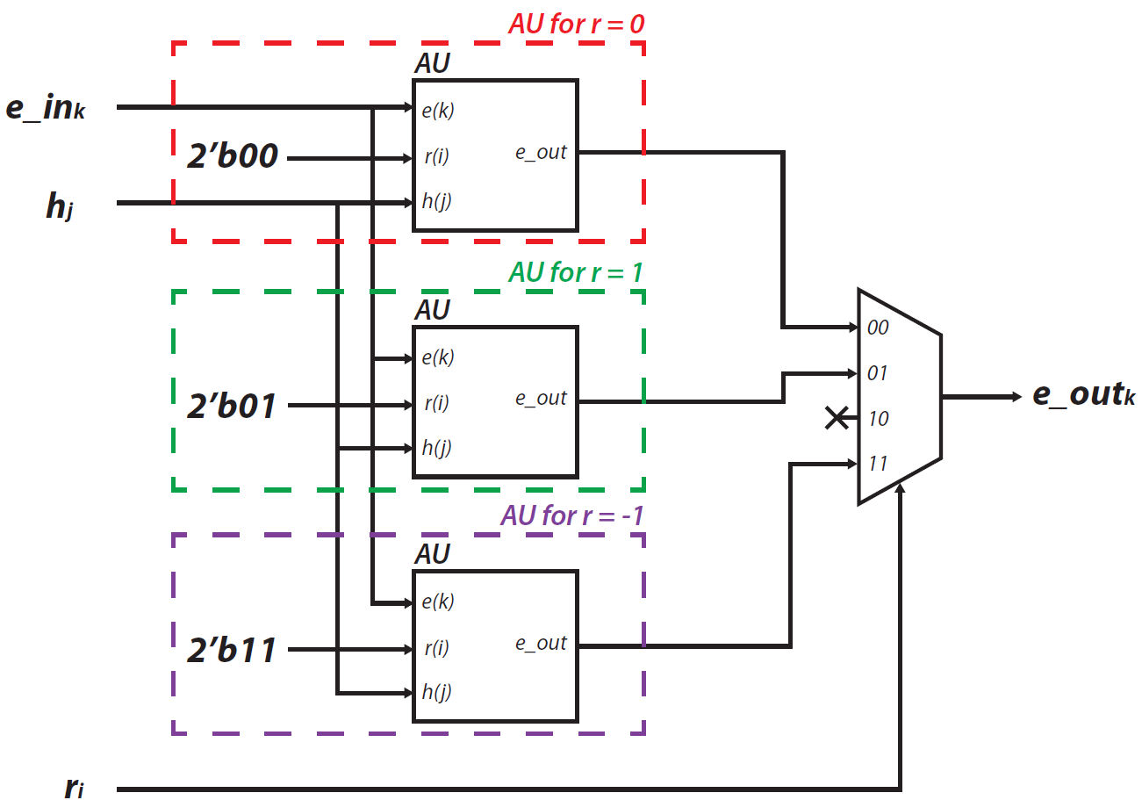
PQC: NTRU SCA
First Countermeasure
Second Countermeasure
43

Slide 44
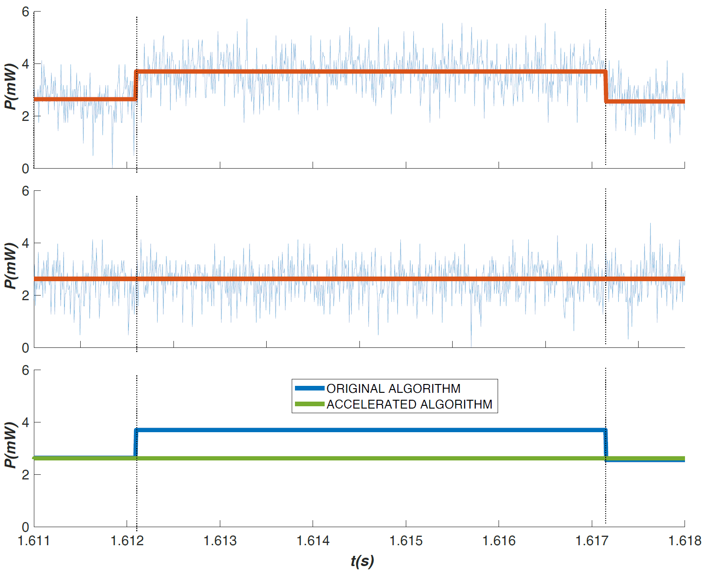
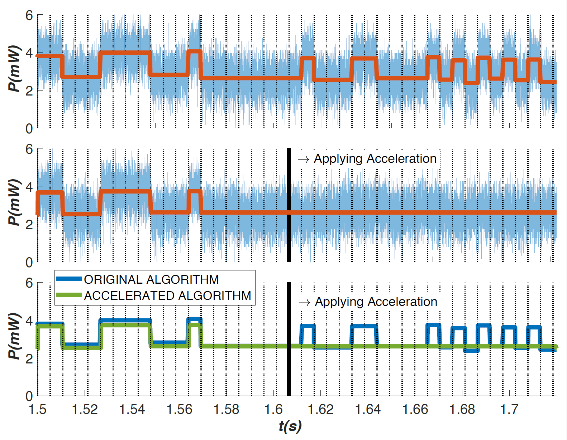
PQC: NTRU SCA
Third Countermeasure
Not using 0’s in the multiplication operation
More closer …
44

Slide 45
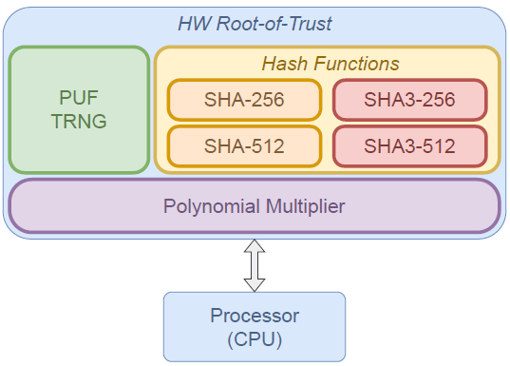
Proof-of-Concept
Combine modules in a RoT
System-on-Chip (SoC)
IoT Environment
Root-of-Trust
Digital PUF
Digital TRNG
SHA2 / SHA3
NTRU accelerator
PoC
HMAC
NTRU
45

Slide 46
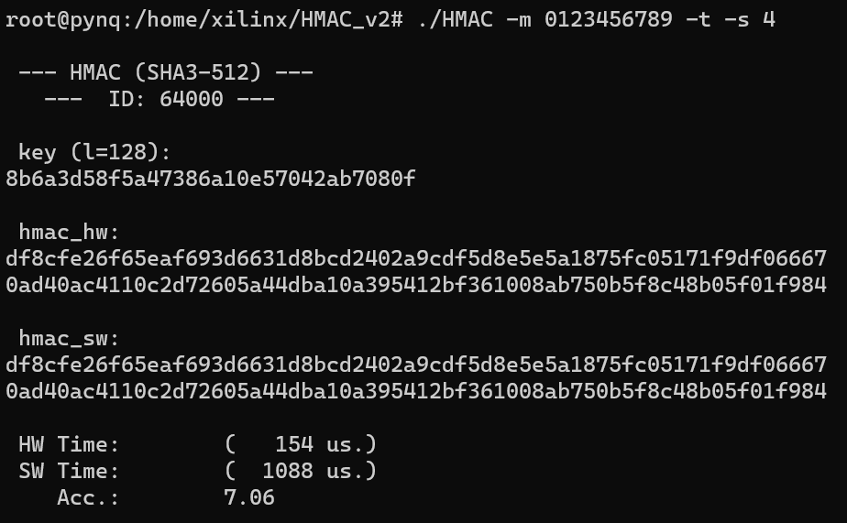
PoC: HMAC
HMAC
Message Verification
46

Slide 47
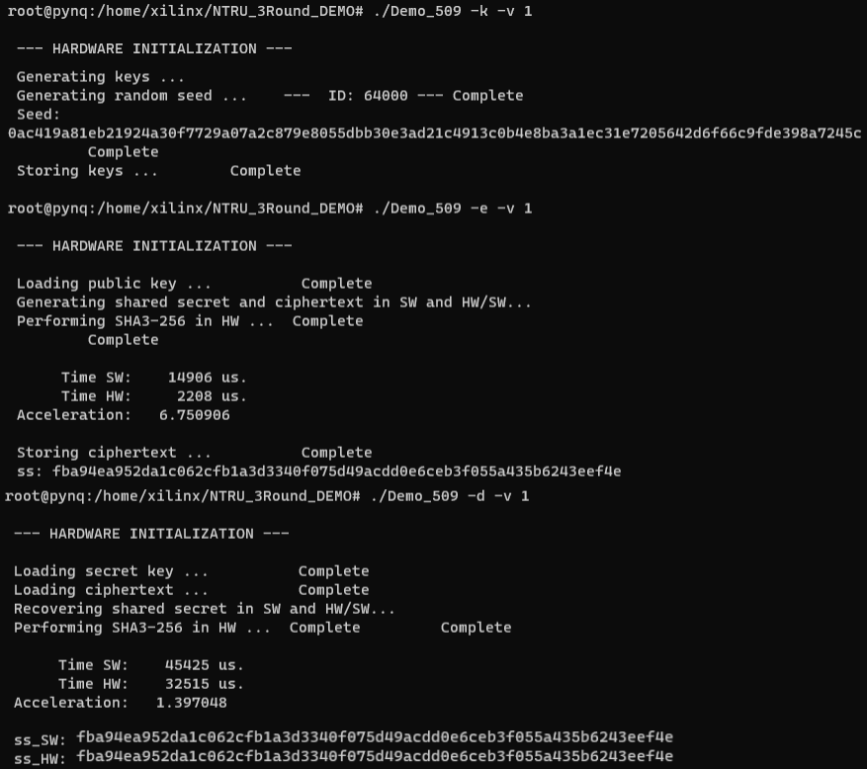
PoC: NTRU
Improvement of the already presented
NTRU
47

Slide 48
Conclusions
The establishment of a hardware RoT significantly bolsters the security of an embedded system. This enhancement is not only robust but also efficient, making it a critical component in the design of secure systems. The considerations for implementation within the framework of the IoT have led to a streamlined design of the RoT. This design is mindful of the constraints of IoT devices, particularly the size of transistors or the occupancy of logic resources in terms of FPGA implementations. The result is a compact yet powerful RoT that fits within the limited resources of IoT devices while providing robust security. In addition to the primary conclusion, there are several other insights extracted from this dissertation. These insights shed light on various aspects of the cryptosystem and contribute to our understanding of its design and implementation. They serve as valuable outcomes that can guide future research and development in this field. These conclusions are:
48

Slide 49
Conclusions
1. Taking inspiration of the CIA triad as model designed to guide policies for information security, the design of a RoT that encompasses a set of crypto primitives is a suitable solution. The approach taken in this dissertation is primarily from a hardware-oriented perspective. This proposed RoT has included a PUF, which can be used as an identifier generator. They also incorporate hash functions, represented by SHA-2 and SHA-3, which are essential for ensuring data integrity. Moreover, it includes a cryptographic primitive that can securely accelerate the computation of PQC algorithms. One such PQC algorithm is NTRU, which is known for its security and efficiency. The integration of these components within a RoT provides a robust and secure hardware solution for addressing the principles of the CIA Triad in the IoT framework.
49

Slide 50
Conclusions
2. The initial module developed in this dissertation was a PUF based on a typically undesirable phenomenon known as RTN. Several architectures were proposed in which, basically, the response of the PUF is obtained comparing one metric that encapsulate all the RTN information, the MPF. The initial stages involved designing and evaluating the PUF from a software perspective, which included conducting several simulations. Once positive results were obtained from these simulations, the next phase involved integrating this PUF into an ASIC. This process followed an analog design flow, culminating in the creation of the first silicon-based RTN-PUF, referred to as MILESTONE-I. The successful results of this endeavor led to the filing of an international patent.
50

Slide 51
Conclusions
3. The following modules developed were those associated with hash functions. After studying the mathematical background of both selected hash functions (SHA-2 and SHA-3), the first step involved implementing the RTL in an FPGA. To this end, a comprehensive set of parameters was incorporated into the integration of these hash functions into IP modules, allowing the implementation of any of the hash versions collected in the standards. One of these designs, specifically SHA-256, was chosen for integration into an ASIC, following a fully digital design flow.
51

Slide 52
Conclusions
4. The final module that was developed was related to the acceleration of one of the
algorithms selected by NIST in the third round of the PQC contest: the NTRU. In that algorithm, the critical component is the polynomial multiplication. To address this, a RTL design was developed, incorporating all the parameter sets outlined in the documentation. Consideration was given not only to performance but also to potential information leakage associated with timing and power attacks. The results demonstrated that it is feasible to enhance the speed of the algorithm while adding an additional layer of security against SCAs.
52

Slide 53
Conclusions
5. Lastly, a final design of the RoT was proposed, integrating all modules into a single hardware platform. This comprehensive design was evaluated in various scenarios, demonstrating the reusability of each module. The results were highly promising, underscoring the effectiveness of this integrated approach in enhancing the security and efficiency of the embedded systems.
53

Slide 55
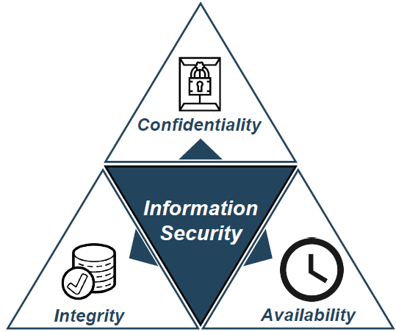
Introduction
55

Slide 56


Introduction
https://www.enisa.europa.eu/publications/good-practices-for-security-of-iot-1/@@download/fullReport
https://www.enisa.europa.eu/publications/guidelines-for-securing-the-internet-of-things/@@download/fullReport
56

Slide 57


Introduction
https://qubip.eu/
57

Slide 58


Introduction
58

Slide 59

PUF: Architecture
59

Slide 60




PUF: Bit Selection Method and Metrics
60

